Slide 1
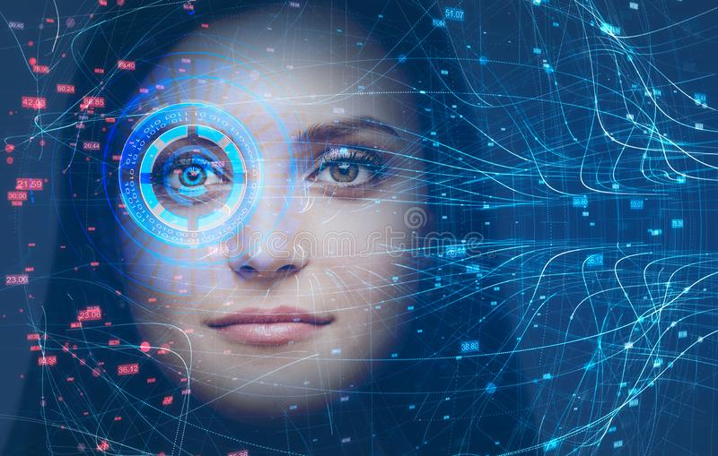
Face recognition
Presented By: Khanak Gupta (2002051028)

Slide 2
Content
Introduction
Biometrics
Computer vision
Objective
Software Requirement
Methodology
Haar Cascade Algorithm
LBPH Algorithm
How it works
Future of this technology
Advantages and disadvantages

Slide 3

introduction

Slide 4
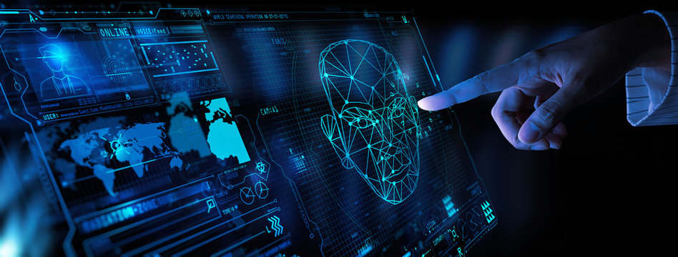
Introduction (face recognition)
Face recognition is a cutting-edge technology that allows computers to identify and verify human faces using digital images or videos.
By analyzing facial features such as the distance between the eyes, the shape of the nose, and the contours of the face, face recognition algorithms can accurately identify individuals and even predict their emotions.

Slide 5
Biometrics
What is Biometrics?
Biometrics is the science of establishing human identity by using physical traits (such as face, fingerprint, and iris) and behavioral traits (such as keystroke and gait)
Biometric facial recognition uses unique mathematical and dynamic patterns works as a face scanner that make this system one of the safest and most effective ones.

Slide 6
Computer vision
What is Computer Vision?
Computer vision is one of the fields of Artificial Intelligence that trains and enables computers to understand the visual world. Computers can use digital images and deep learning models to accurately identify and classify objects and react to them.
The idea behind computer vision is to instruct computers to interpret and comprehend images on a pixel-by-pixel basis.

Slide 7
Slide title 29
OBJECTIVE

Slide 8

OBJECTIVES
Accurately detect faces in images or video frames using Haar Cascade algorithm.
Extract meaningful features from the detected faces using LBPH algorithm.
Build a robust face recognition model that can identify individuals in real-time with high accuracy and reliability.
Implement the face recognition system in a user-friendly way, such as through a graphical user interface (GUI).

Slide 9
Slide title 29
Software requirement

Slide 10


Software requirement
Python(version 3.10)
PyCharm
OpenCV Python(python library)
Some other python libraries like numpy , os , tkinter, mysql-connector, etc.

Slide 11
Slide title 29
methodology

Slide 12
methodology
In this project Haar-Cascade Algorithm is used for face detection and Local Binary Patterns Histograms(LBPH) is used for face recognition process.

Slide 13
Haar cascade
Haar Cascade is a machine learning-based object detection algorithm that is commonly used for face detection.
The algorithm works by analyzing the differences in grayscale intensities of adjacent rectangular regions (features) of an image to identify patterns that correspond to a specific object or feature of interest.
Trains positive and negative images.
Positive images are those images that consist of faces.
negative images are without faces.
In face detection, image features are treated as numerical information extracted from the pictures that can distinguish one image from another.
The haarcascade_frontalface_default.xml is a haar cascade designed by OpenCV to detect the frontal face.

Slide 14
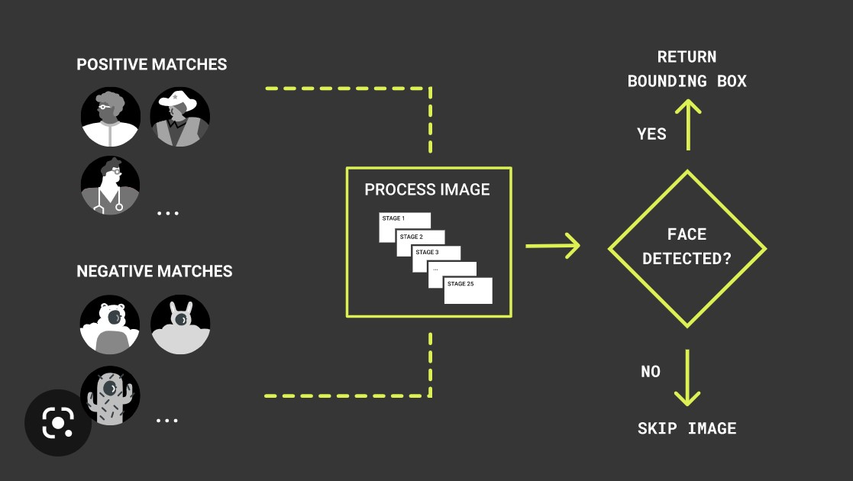
ccx

Slide 15
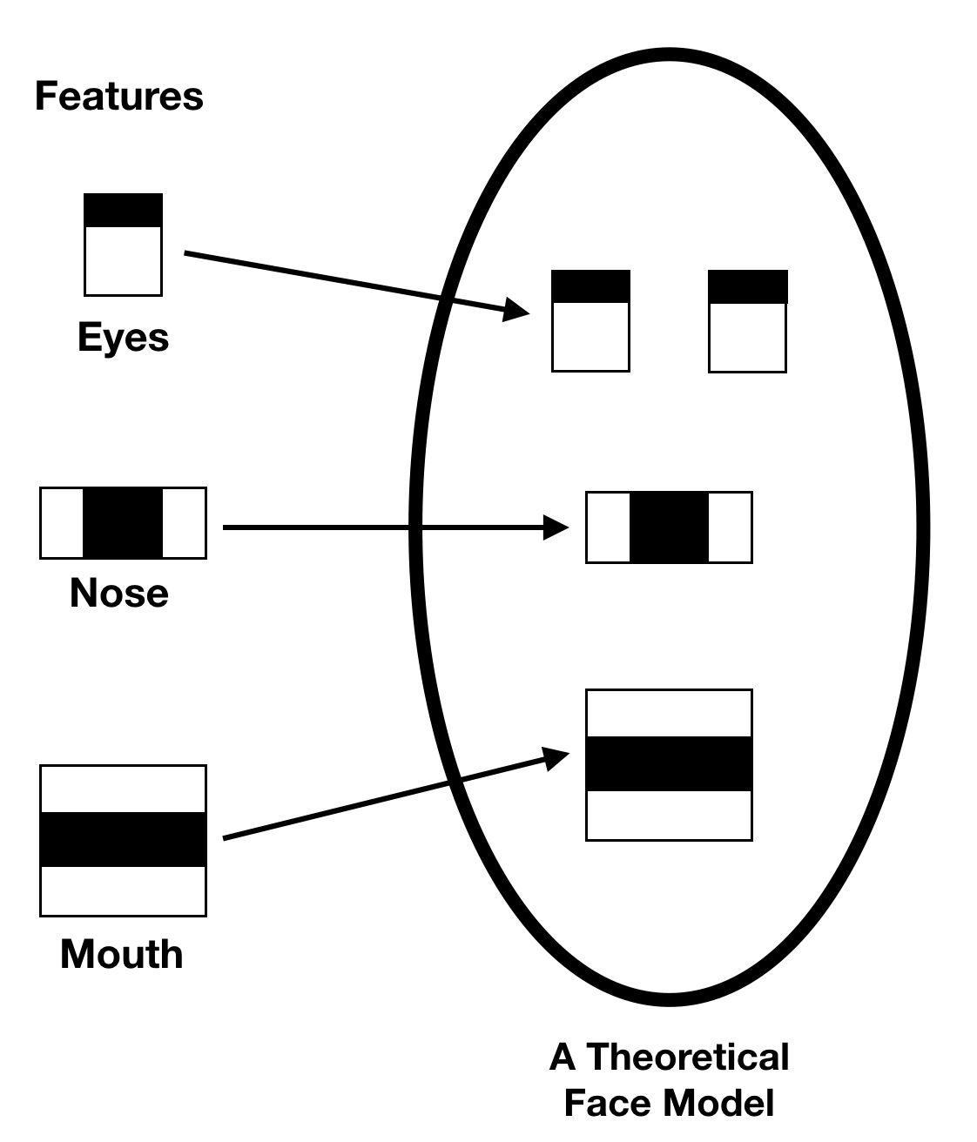
Computation of features
detectMultiscale()module
To create rectangle around the faces detected in image.
Parameters:
scaleFactor=Specifies how much the image size is reduces at each image scale.
minNeighbours=specifies how many neighbours each candidate rectangle should have retain it.
Cascade of Classifiers
Features are grouped together into stages of classifiers
If a window fails at 1st stage it is discarded.
Else it passed onto 2nd stage of feature
The window which passes all stages is face region.

Slide 16
Lbph algorithm
LBPH stands for local binary pattern histogram
Local Binary Pattern (LBP) is a simple yet very efficient texture operator which labels the pixels of an image by thresholding the neighbourhood of each pixel and considers the result as a binary number.
Using the LBP combined with histograms we can represent the face images with a simple data vector.
It uses 4 parameters: Radius, Neighbours , Grid X, Grid Y.
we need to train the algorithm.
To do so, we need to use a dataset with the facial images of the people we want to recognize.
We need to also set an ID (it may be a number or the name of the person) for each image, so the algorithm will use this information to recognize an input image and give you an output.
Images of the same person must have the same ID.

Slide 17
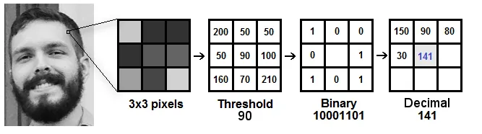
Extracting a portion of grayscale image(3 X 3 pixels)
Represented in a matrix of 3x3 pixel intensities with each pixel intensity in range (0-255)
Using centre value as threshold and perform thresholding(0=<threshold,1=>threshold)
Obtain binary values and concatenate in clockwise manner.
Convert binary value to decimal value and set it to centre value.
In the end , we have obtained a new image with better characteristics.

Slide 18
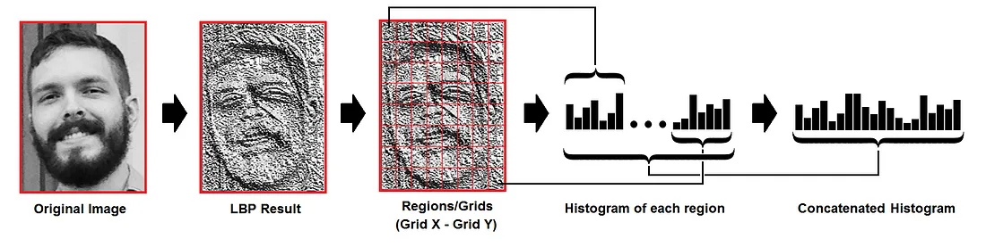
Lbp combined with histogram to predict faces
Now we divide the new image generated into grids with Grid X and Grid Y parameters.
Obtain the histogram of each grid.
Now concatenate the individual histograms to obtain a new and bigger histogram .
The final histogram represents characteristics of original image.

Slide 19
The algorithm is trained and each histogram is used to represent each image of training dataset.
We compare the two histograms and return the image with closest histogram.
The output is the id with closest match and the calculated Eclidean distance can be a confidence measurement.
Confidence level:
The lower the value of confidence the better is the match which means the distance between two histograms is closer.
Then we can use this confidence level to predict the face by defining the threshold.
Formula used : 100X(1-predict/300)

Slide 20
Our process is easy
Creating dataset
Training data set
Predicting faces in real time

Slide 21
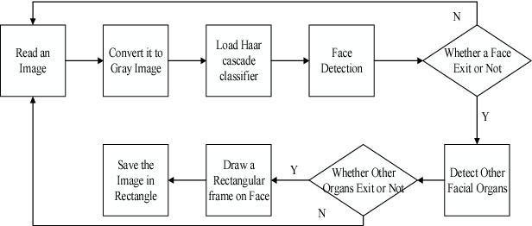
Flow chart of lbph algorithm

Slide 22
Slide title 29
How it works

Slide 23
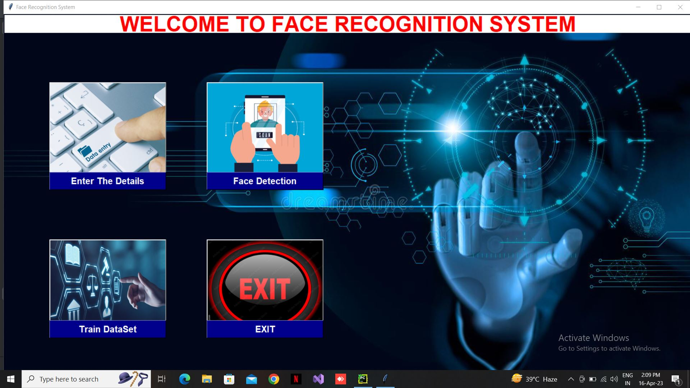
How it works
First of all click on Enter the details button to enter the details of a person in Database.

Slide 24
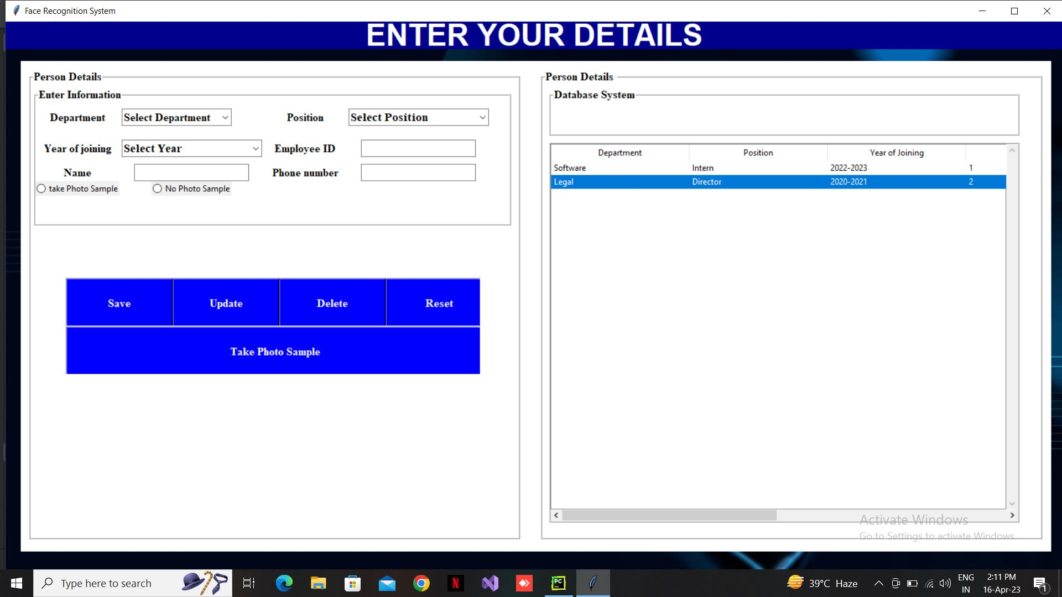
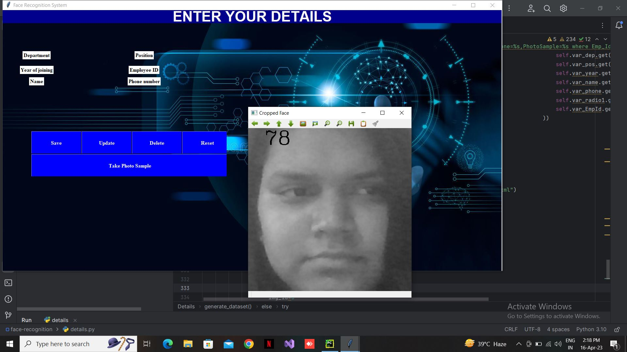
How it works cont….
2. Enter the details of the person take photo sample and save their details in Database and save sample photos to the folder data.

Slide 25

How it works cont.....
3. After taking the photo samples click on train dataset button on the main window . So the below window will appear then click on train data to start the process for training of dataset.

Slide 26
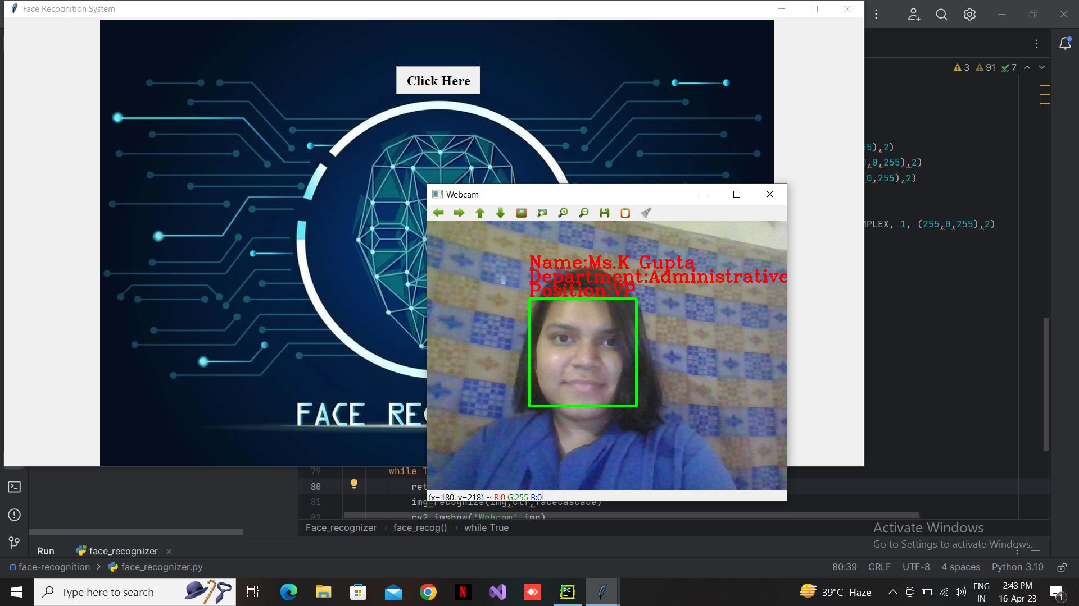
How it works cont…
4. After the training of data is completed click on face detection and then click on click here button .You will se that the face recognition works and it will identify you and also display your name and other information about you on webcam

Slide 27
Future of face recognition system
Accuracy: As machine learning and computer vision technologies continue to advance, the accuracy of face recognition systems is expected to improve. This may involve better feature extraction techniques, more sophisticated classifiers, and larger training datasets, leading to higher detection and recognition rates and reduced false positives and false negatives.
Robustness: Efforts may be made to enhance the robustness of face recognition systems to varying lighting conditions, poses, facial expressions, and other factors that can affect detection and recognition performance. This may involve incorporating advanced image processing techniques, multi-modal approaches, and more robust feature extraction algorithms to make the system more reliable and effective in different environments and scenarios.
Deep learning approaches: Deep learning-based approaches, such as Convolutional Neural Networks (CNNs) and Recurrent Neural Networks (RNNs), are gaining popularity in the field of computer vision, including face recognition. Future developments may involve incorporating deep learning techniques into face recognition systems to improve accuracy, robustness, and scalability, as deep learning has shown promising results in many other computer vision tasks.
Integration with other technologies: Face recognition systems may be integrated with other technologies, such as biometrics, Internet of Things (IoT), cloud computing, and artificial intelligence (AI), to enable more advanced functionalities and applications.

Slide 28
ADVANTAGES AND DISADVANTAGES
ADVANTAGES
DISADVANTAGES
Increased Security: Face recognition technology can be used to enhance security in various applications, such as access control, surveillance, and border control.
Convenience: Face recognition technology eliminates the need for physical keys or passwords, making it more convenient and faster to access secure areas or devices.
Efficiency: Face recognition technology can save time and increase efficiency in various applications, such as in retail, marketing, and law enforcement.
Scalability: Face recognition technology can be easily scaled to accommodate large datasets and high volumes of traffic, making it suitable for use in various applications and industries.
Non-intrusive: Face recognition technology is non-intrusive and does not require physical contact or interaction with individuals, making it more user-friendly and less invasive compared to other biometric technologies.
Privacy Concerns: Face recognition technology raises privacy concerns as it collects, stores, and uses individuals' biometric data.
Bias and Discrimination: Face recognition technology can be biased and discriminatory, especially towards certain demographic groups. This can lead to unfair treatment and potential harm to individuals.
Technical Challenges: Face recognition technology requires significant computational resources, including high-performance hardware and advanced algorithms.
Vulnerability to Spoofing: Face recognition technology is vulnerable to spoofing, where individuals can trick the system by using fake images or masks.
Limited Use in Some Scenarios: Face recognition technology may not be suitable for use in some scenarios, such as in cases where individuals are wearing masks or other face coverings, or where there are privacy concerns or cultural sensitivities around the collection and use of biometric data.

Slide 29
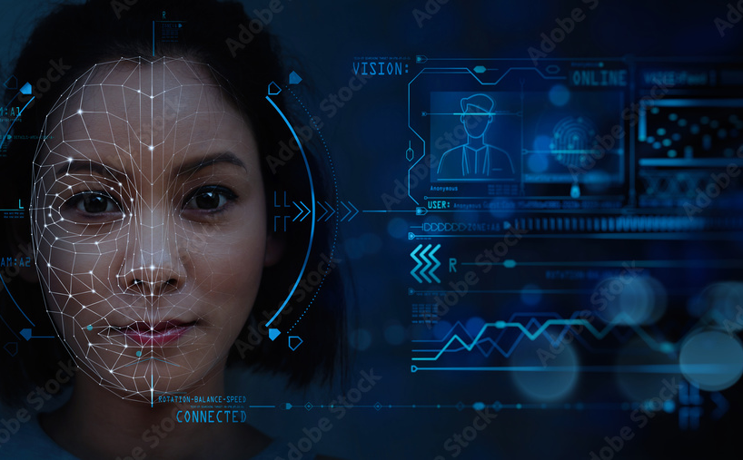
THANK YOU

